Slide 1
Word embeddings (continued)
Idea: learn an embedding from words into vectors
Need to have a function W(word) that returns a vector encoding that word.

Slide 2
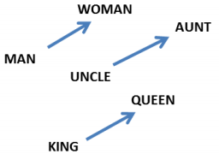

Word embeddings: properties
Relationships between words correspond to difference between vectors.
http://colah.github.io/posts/2014-07-NLP-RNNs-Representations/

Slide 3
Word embeddings: questions
How big should the embedding space be?
Trade-offs like any other machine learning problem – greater capacity versus efficiency and overfitting.
How do we find W?
Often as part of a prediction or classification task involving neighboring words.

Slide 4
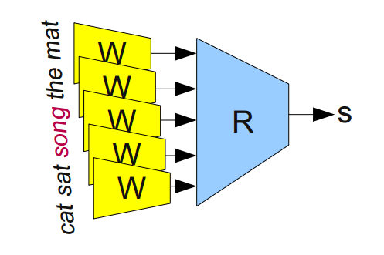
Learning word embeddings
First attempt:
Input data is sets of 5 words from a meaningful sentence. E.g., “one of the best places”. Modify half of them by replacing middle word with a random word. “one of function best places”
W is a map (depending on parameters, Q) from words to 50 dim’l vectors. E.g., a look-up table or an RNN.
Feed 5 embeddings into a module R to determine ‘valid’ or ‘invalid’
Optimize over Q to predict better
https://arxiv.org/ftp/arxiv/papers/1102/1102.1808.pdf
http://colah.github.io/posts/2014-07-NLP-RNNs-Representations/

Slide 5
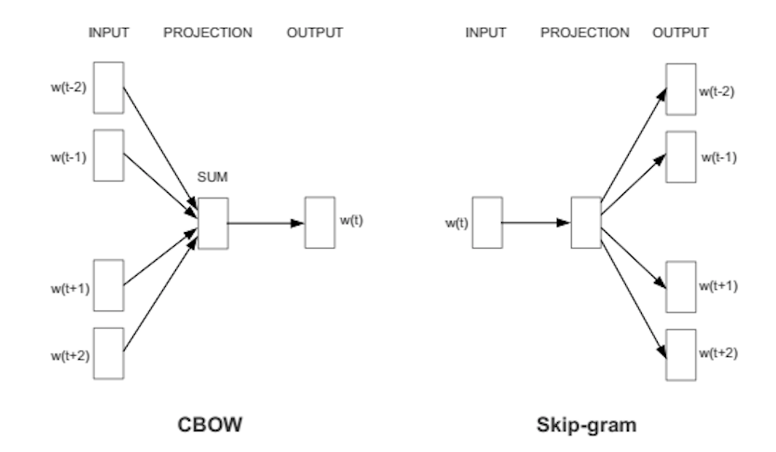
word2vec
Predict words using context
Two versions: CBOW (continuous bag of words) and Skip-gram
https://skymind.ai/wiki/word2vec

Slide 6
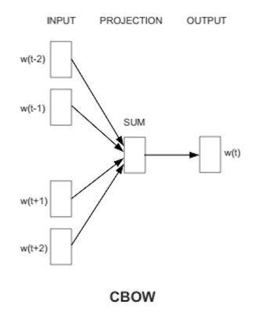
CBOW
Bag of words
Gets rid of word order. Used in discrete case using counts of words that appear.
CBOW
Takes vector embeddings of n words before target and n words after and adds them (as vectors).
Also removes word order, but the vector sum is meaningful enough to deduce missing word.

Slide 7
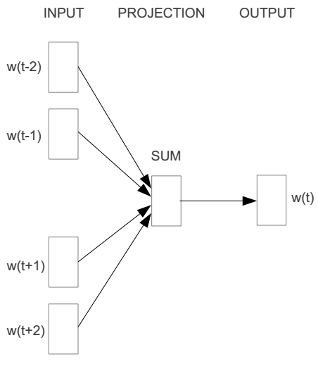
Word2vec – Continuous Bag of Word
E.g. “The cat sat on floor”
Window size = 2
the
cat
sat
on
floor
www.cs.ucr.edu/~vagelis/classes/CS242/slides/word2vec.pptx

Slide 8
Input layer
Index of cat in vocabulary
0
1
0
cat
0
Hidden layer
Output layer
0
0
0
0
0
0
…
0
0
0
one-hot
vector
0
sat
one-hot
vector
0
0
0
0
1
0
…
1
0
on
0
0
0
0
…
0
www.cs.ucr.edu/~vagelis/classes/CS242/slides/word2vec.pptx

Slide 9



We must learn W and W’
Input layer
0
1
0
cat
0
$$W_{V×N}$$
Hidden layer
Output layer
0
0
0
0
0
0
V-dim
…
0
0
$${W′}_{N×V}$$
0
0
sat
0
0
0
0
1
0
$$W_{V×N}$$
N-dim
…
V-dim
1
0
on
0
0
0
0
V-dim
…
N will be the size of word vector
0
www.cs.ucr.edu/~vagelis/classes/CS242/slides/word2vec.pptx

Slide 10
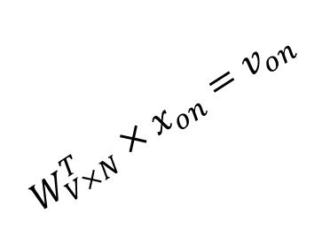

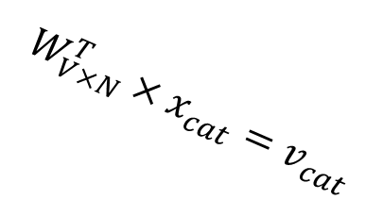



$$W_{V×N}^{T} ×x_{cat}=v_{cat}$$
0.1 | 2.4 | 1.6 | 1.8 | 0.5 | 0.9 | … | … | … | 3.2
0.5 | 2.6 | 1.4 | 2.9 | 1.5 | 3.6 | … | … | … | 6.1
… | … | … | … | … | … | … | … | … | …
… | … | … | … | … | … | … | … | … | …
0.6 | 1.8 | 2.7 | 1.9 | 2.4 | 2.0 | … | … | … | 1.2
0
2.4
2.6
…
…
1.8
Input layer
1
$$×$$
0
$$=$$
0
0
1
0
0
0
x_{cat}
0
0
Output layer
0
0
0
$$W_{V×N}^{T}×x_{cat}=v_{cat}$$
…
0
0
0
0
0
V-dim
…
0
0
$$\hat{v}=\frac{v_{cat}+v_{on}}{2}$$
0
+
0
sat
0
0
0
0
$$W_{V×N}^{T}×x_{on}=v_{on}$$
1
0
…
V-dim
1
Hidden layer
0
x_{on}
0
0
N-dim
0
0
V-dim
…
0
www.cs.ucr.edu/~vagelis/classes/CS242/slides/word2vec.pptx

Slide 11

$$W_{V×N}^{T} ×x_{on}=v_{on}$$
0.1 | 2.4 | 1.6 | 1.8 | 0.5 | 0.9 | … | … | … | 3.2
0.5 | 2.6 | 1.4 | 2.9 | 1.5 | 3.6 | … | … | … | 6.1
… | … | … | … | … | … | … | … | … | …
… | … | … | … | … | … | … | … | … | …
0.6 | 1.8 | 2.7 | 1.9 | 2.4 | 2.0 | … | … | … | 1.2
0
1.8
2.9
…
…
1.9
Input layer
0
$$×$$
0
$$=$$
0
1
1
0
0
0
x_{cat}
0
0
Output layer
0
0
0
$$W_{V×N}^{T}×x_{cat}=v_{cat}$$
…
0
0
0
0
0
V-dim
…
0
0
$$\hat{v}=\frac{v_{cat}+v_{on}}{2}$$
0
+
0
sat
0
0
0
0
$$W_{V×N}^{T}×x_{on}=v_{on}$$
1
0
…
V-dim
1
Hidden layer
0
x_{on}
0
0
N-dim
0
0
V-dim
…
0
www.cs.ucr.edu/~vagelis/classes/CS242/slides/word2vec.pptx

Slide 12






Input layer
0
1
0
cat
0
$$W_{V×N}$$
Hidden layer
Output layer
0
0
0
0
0
0
V-dim
…
0
0
$$W_{V×N}^{′}×\hat{v}=z$$
0
$$\hat{y}=softmax(z)$$
0
0
0
0
0
$$\hat{v}$$
1
0
$$W_{V×N}$$
…
1
N-dim
0
on
0
${\hat{y}}_{sat}$
0
0
V-dim
0
V-dim
…
N will be the size of word vector
0
www.cs.ucr.edu/~vagelis/classes/CS242/slides/word2vec.pptx

Slide 13


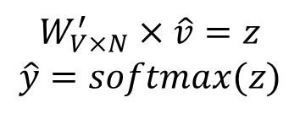
Input layer
0
We would prefer $\hat{y}$ close to ${\hat{y}}_{sat}$
1
0
cat
0
$$W_{V×N}$$
Hidden layer
Output layer
0
0
0
0
0.01
0.02
0.00
0.02
0.01
0.02
0.01
0.7
…
0.00
0
0
V-dim
…
0
0
$$W_{V×N}^{′}×\hat{v}=z$$
$$\hat{y}=softmax(z)$$
0
0
0
0
0
0
$$\hat{v}$$
1
0
$$W_{V×N}$$
…
1
N-dim
0
on
0
${\hat{y}}_{sat}$
0
0
V-dim
0
V-dim
…
N will be the size of word vector
$\hat{y}$
0
www.cs.ucr.edu/~vagelis/classes/CS242/slides/word2vec.pptx

Slide 14




$$W_{V×N}^{T}$$
0.1 | 2.4 | 1.6 | 1.8 | 0.5 | 0.9 | … | … | … | 3.2
0.5 | 2.6 | 1.4 | 2.9 | 1.5 | 3.6 | … | … | … | 6.1
… | … | … | … | … | … | … | … | … | …
… | … | … | … | … | … | … | … | … | …
0.6 | 1.8 | 2.7 | 1.9 | 2.4 | 2.0 | … | … | … | 1.2
Contain word’s vectors
Input layer
0
1
0
x_{cat}
0
Output layer
0
0
$$W_{V×N}^{}$$
0
0
0
0
V-dim
…
0
0
$$W_{V×N}^{′}$$
0
0
sat
0
0
0
0
1
0
$$W_{V×N}^{}$$
…
1
0
V-dim
x_{on}
0
Hidden layer
0
N-dim
0
0
V-dim
…
0
We can consider either W or W’ as the word’s representation. Or even take the average.
www.cs.ucr.edu/~vagelis/classes/CS242/slides/word2vec.pptx
Notes:
W contains input word vectors.
W’ contains output word vectors.
We can consider either W or W’ as the word’s representation. Or even take the average.

Slide 15
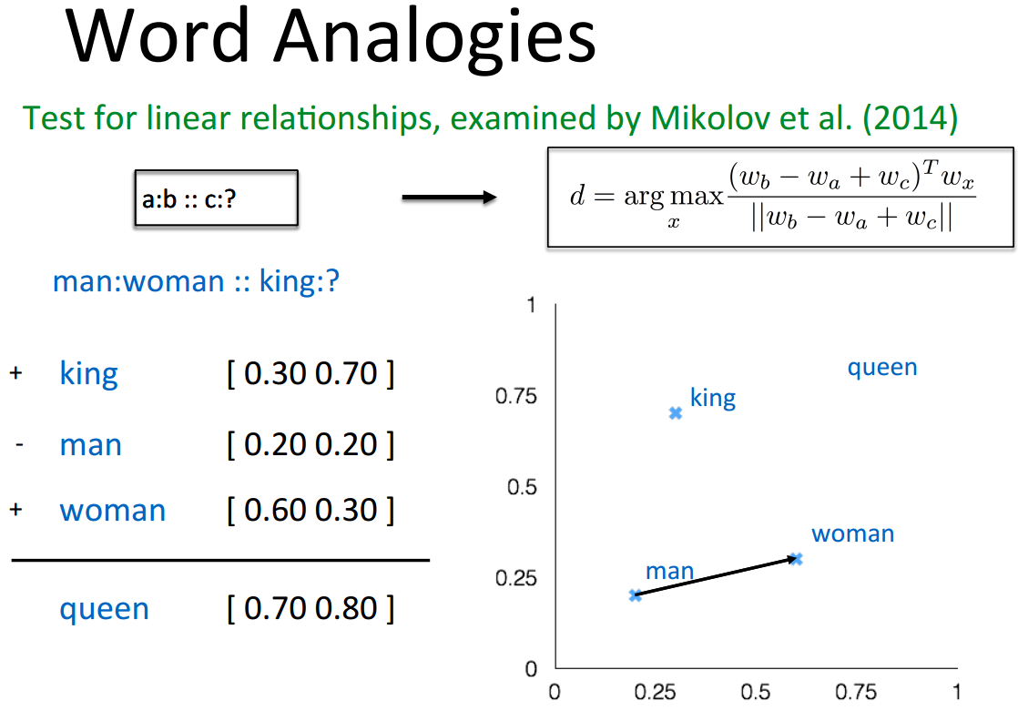
Some interesting results
www.cs.ucr.edu/~vagelis/classes/CS242/slides/word2vec.pptx

Slide 16
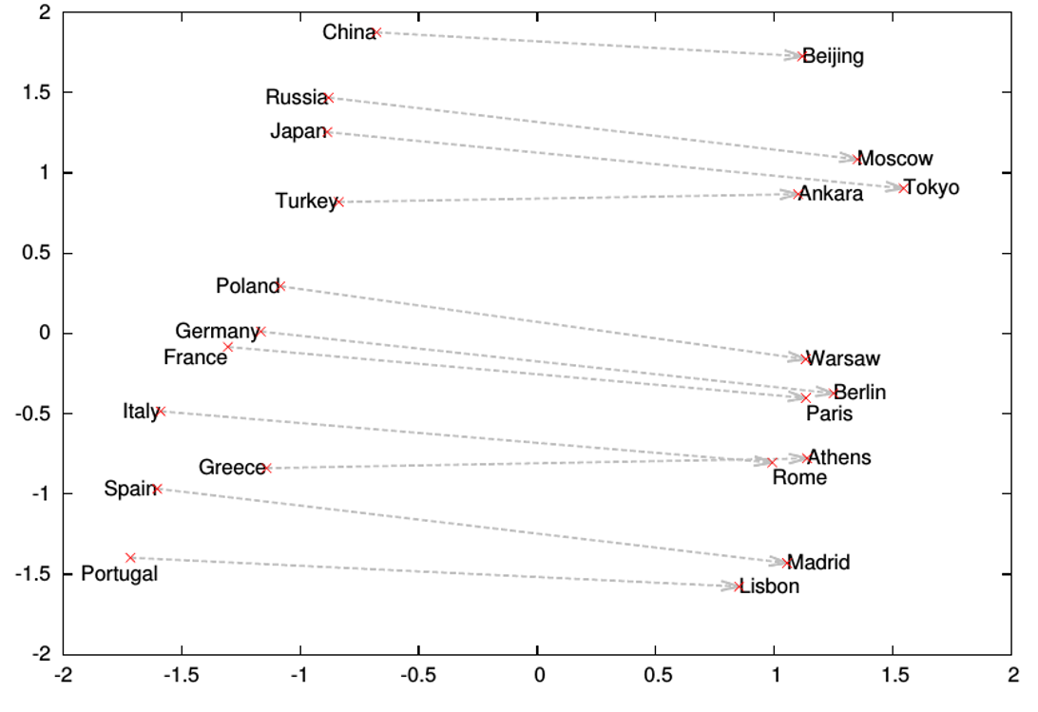
Word analogies
www.cs.ucr.edu/~vagelis/classes/CS242/slides/word2vec.pptx

Slide 17
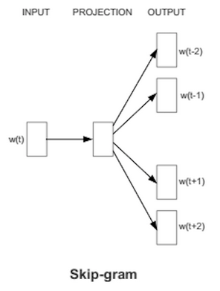
Skip gram
Skip gram – alternative to CBOW
Start with a single word embedding and try to predict the surrounding words.
Much less well-defined problem, but works better in practice (scales better).

Slide 18
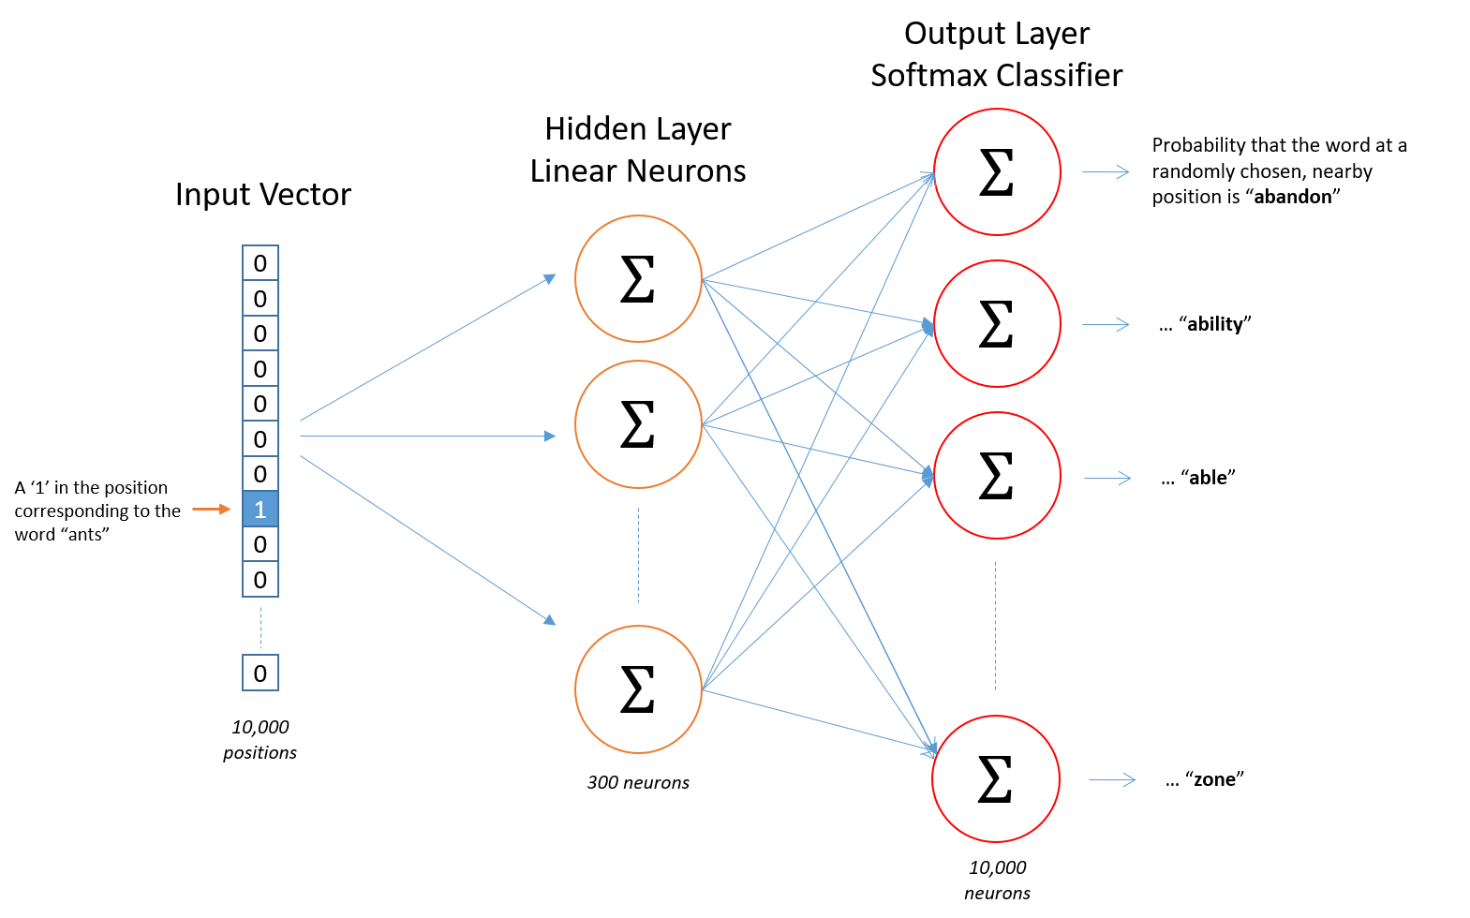
Skip gram
Map from center word to probability on surrounding words. One input/output unit below.
There is no activation function on the hidden layer neurons, but the output neurons use softmax.
http://mccormickml.com/2016/04/19/word2vec-tutorial-the-skip-gram-model/

Slide 19
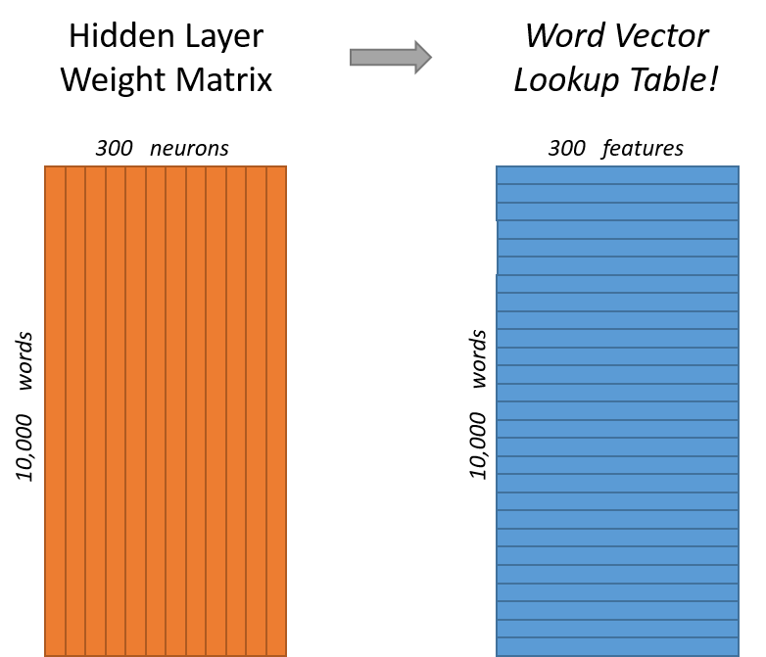
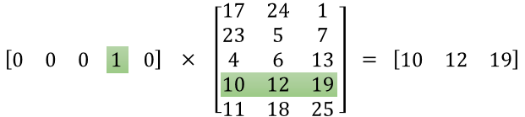
Skip gram example
Vocabulary of 10,000 words.
Embedding vectors with 300 features.
So the hidden layer is going to be represented by a weight matrix with 10,000 rows (multiply by vector on the left).
http://mccormickml.com/2016/04/19/word2vec-tutorial-the-skip-gram-model/

Slide 20
Skip gram/CBOW intuition
Similar “contexts” (that is, what words are likely to appear around them), lead to similar embeddings for two words.
One way for the network to output similar context predictions for these two words is if the word vectors are similar. So, if two words have similar contexts, then the network is motivated to learn similar word vectors for these two words!
http://mccormickml.com/2016/04/19/word2vec-tutorial-the-skip-gram-model/

Slide 21
Word2vec shortcomings
Problem: 10,000 words and 300 dim embedding gives a large parameter space to learn. And 10K words is minimal for real applications.
Slow to train, and need lots of data, particularly to learn uncommon words.

Slide 22
Word2vec improvements: word pairs and phrases
Idea: Treat common word pairs or phrases as single “words.”
E.g., Boston Globe (newspaper) is different from Boston and Globe separately. Embed Boston Globe as a single word/phrase.
Method: make phrases out of words which occur together often relative to the number of individual occurrences. Prefer phrases made of infrequent words in order to avoid making phrases out of common words like “and the” or “this is”.
Pros/cons: Increases vocabulary size but decreases training expense.
Results: Led to 3 million “words” trained on 100 billion words from a Google News dataset.

Slide 23
Word2vec improvements: subsample frequent words
Idea: Subsample frequent words to decrease the number of training examples.
The probability that we cut the word is related to the word’s frequency. More common words are cut more.
Uncommon words (anything < 0.26% of total words) are kept
E.g., remove some occurrences of “the.”
Method: For each word, cut the word with probability related to the word’s frequency.
Benefits: If we have a window size of 10, and we remove a specific instance of “the” from our text:
As we train on the remaining words, “the” will not appear in any of their context windows.

Slide 24
Word2vec improvements: selective updates
Idea: Use “Negative Sampling”, which causes each training sample to update only a small percentage of the model’s weights.
Observation: A “correct output” of the network is a one-hot vector. That is, one neuron should output a 1, and all of the other thousands of output neurons to output a 0.
Method: With negative sampling, randomly select just a small number of “negative” words (let’s say 5) to update the weights for. (In this context, a “negative” word is one for which we want the network to output a 0 for). We will also still update the weights for our “positive” word.

Slide 25
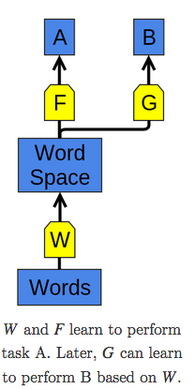
Word embedding applications
The use of word representations… has become a key “secret sauce” for the success of many NLP systems in recent years, across tasks including named entity recognition, part-of-speech tagging, parsing, and semantic role labeling. (Luong et al. (2013))
Learning a good representation on a task A and then using it on a task B is one of the major tricks in the Deep Learning toolbox.
Pretraining, transfer learning, and multi-task learning.
Can allow the representation to learn from more than one kind of data.
http://colah.github.io/posts/2014-07-NLP-RNNs-Representations/

Slide 26
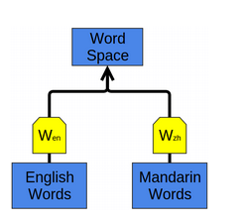
Word embedding applications
Can learn to map multiple kinds of data into a single representation.
E.g., bilingual English and Mandarin Chinese word-embedding as in Socher et al. (2013a).
Embed as above, but words that are known as close translations should be close together.
Words we didn’t know were translations end up close together!
Structures of two languages get pulled into alignment.
http://colah.github.io/posts/2014-07-NLP-RNNs-Representations/

Slide 27
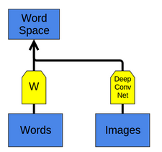
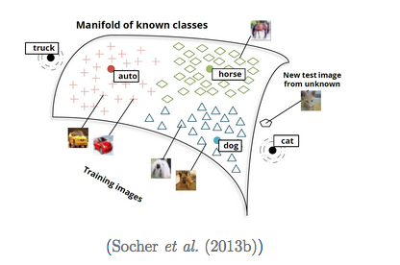
Word embedding applications
Can apply to get a joint embedding of words and images or other multi-modal data sets.
New classes map near similar existing classes: e.g., if ‘cat’ is unknown, cat images map near dog.
http://colah.github.io/posts/2014-07-NLP-RNNs-Representations/

Slide 28
a
http://colah.github.io/posts/2014-07-NLP-RNNs-Representations/

